Slide 1

IMS Project
Adam Stevenson

Slide 2
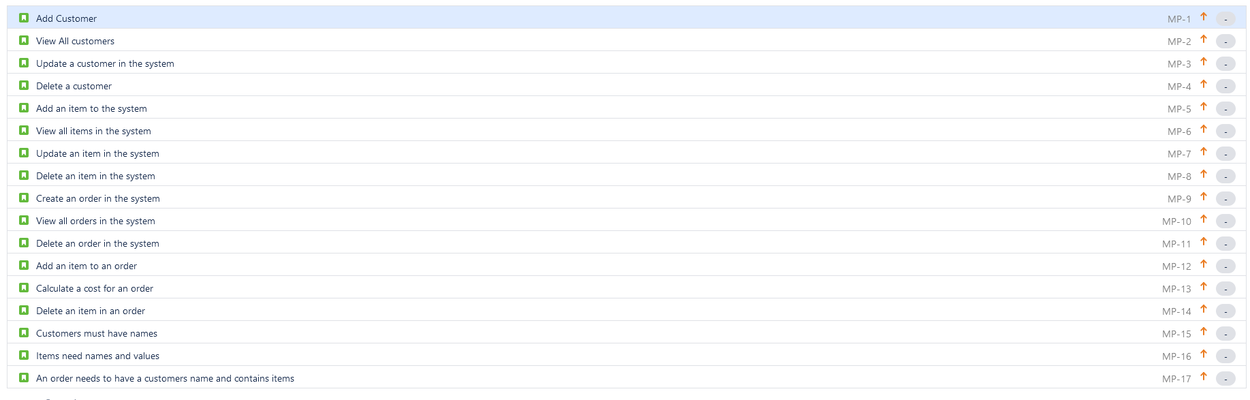




Jira
Adding a customer
Adding an item to an order

Slide 3
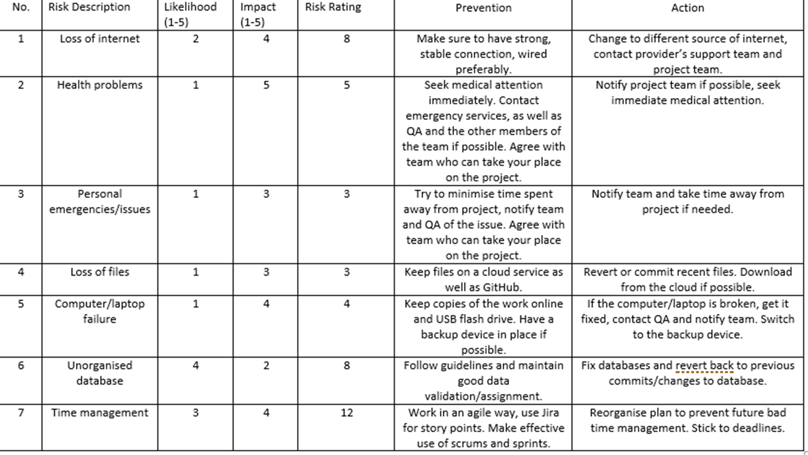
Risk Register

Slide 4
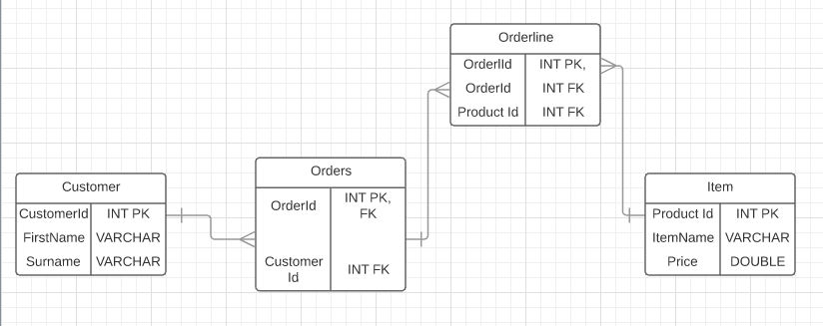
Entity Relationship Diagram
Order line is an additional table that connects both the orders and items together.

Slide 5
Problems I faced
While creating the code I faced many challenges preventing me from completing my project.
These include: Finding the correct query that selected the data from MySQL database, I fixed this after reading through my SQL notes.
Finding the work difficult but I always asked for help in areas I didn’t understand.
I deleted some of my code which broke the IMS and I then needed go back to an older version from my GitHub.

Slide 6
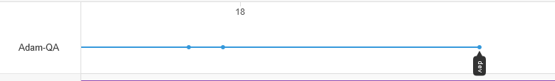
Feature Branch Model
I used the Dev branch as my feature branch and pushed any work I completed in the day to my GitHub, then pushing it to the master branch now that It has been completed.
This was useful to me as it allowed me to go back to an older version of my code after it had gone wrong.

Slide 7
My code!
Now I’m going to show you my IMS!

Slide 8
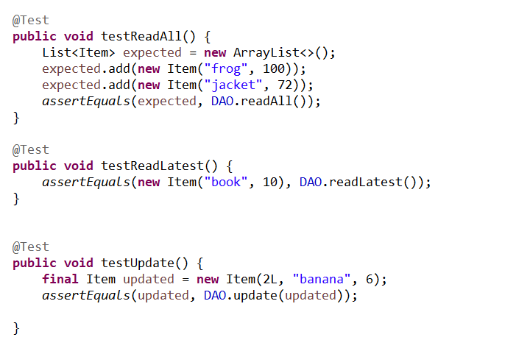
Testing
Using the Maven build tool and Junit, I created tests that ran in my project and covered 56% of the code

Slide 9
What I would change
Make it so when you create an order, you will also add some entries into it.
So you are able to create the order line table without adding original values to it.
Time management with certain areas of the project.

Slide 10
Questions?!
Ask me anything!

